Slide 1

AUGMENTED FRAMEWORK FOR GENERATING DOMAIN-SPECIFIC MOBILE APPLICATIONS THESIS COMMITTEE DR. LEON JOLOLIAN, CHAIR AND ADVISOR DR. MURAT M TANIK DR. MOHAMMAD HAIDER
PREPARED BY
RAMA KRISHNA RAJU RUDRARAJU

Slide 2
BACKGROUND
Education:
Bachelor, Electronics and Communication Engineering, Andhra University (July 2010 - May 2014).
Masters, Electrical and Computer Engineering, University of Alabama at Birmingham (Jan 2016 - present).
Work Experience:
Internship: Associate Web Developer Intern, Vistex, Chicago (Jun 2017- Aug 2017).
Technical Assistant: IT Helpdesk, Department of Hematology & Oncology, UAB (Jan 2017 - Jun 2017).
Relevant Courses:
Mobile Computing (EE-654), Software Engineering (EE-650), Information Systems(EE-690), Database Design(Texas A&M Commerce (CS-520)), C++ Object Oriented Programming(Texas A&M Commerce (CS-535)).

Slide 3
CONTENTS
Problem and Motivation
Literature Review
Methodology and System Architecture
Evaluation
Conclusion and Future Work
2

Slide 4
PROBLEM AND MOTIVATION
In Software Engineering, programming-in-the-large and programming-in- the-small describe two different approaches to writing software. [DeRemer, 1975].
No comprehensive solution for simplifying software development, “No Silver Bullet “[Brooks, 1989].
To cope with large and complex systems, various tools have been suggested. One of the most successful tools are frameworks [G.Rogers, 1997].
Most recently a growing computing trend has emerged: ubiquitous smart devices, with the following characteristics:
1) Programming in the small.
2) Limited Hardware, CPU, and Memory.
3) Access to the cloud.
We propose a methodology that provides guidelines for creating domain-specific Frameworks for developing applications for smart devices.
3

Slide 5
Literature Review
Over the past few decades, frameworks have been, to some extent, successful in simplifying the software development process.
Frameworks provide domain-specific functionality that allow developers to reuse code as well as customization.
In general, a framework is targeted towards a particular domain, For example:
AIBench [Glez, 2000] is a widely used framework in scientific software development where there is need of collecting parameters, executing algorithms, and analyzing the results.
VHD++ [Ponder, 2003] is a component-based framework for developing virtual reality applications to facilitate the integration of software components to generate a finished product.
Software Factory [Greenfield, 2004] is widely used in the Industries where there is a continues need for product-line development to reduce the application update time.
4

Slide 6
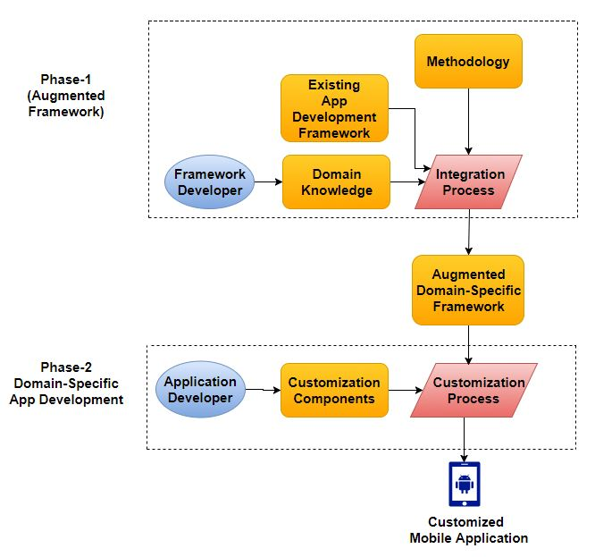
Stakeholders and Workflow Figure 1 : Overview of Phases and Workflow
5

Slide 7
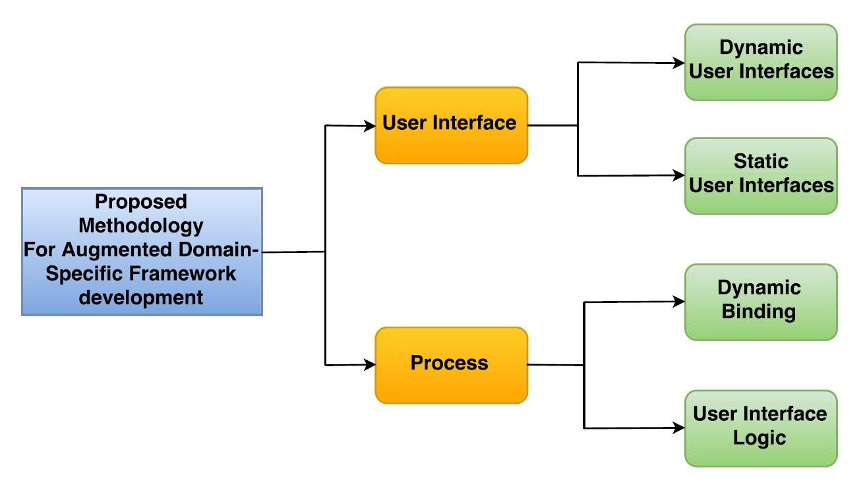
Methodology and System Architecture
The proposed methodology contains guidelines for creating Augmented Domain-Specific Frameworks.
Figure 2 : Methodology
6

Slide 8
User Interface Development
1) Dynamic User Interfaces:
They are associated with the user-interfaces that need to change based on the input at runtime.
2) Static User Interfaces:
They are associated with the user-interfaces that won’t vary based on the input at runtime.
7

Slide 9
Process
Process consists the algorithms that are responsible for integrating external data into the application as well as logic for displaying the appropriate user Interfaces on the mobile screen.
“Process” is divided into two Steps:
1) Dynamic Binding:
In this step the framework-developer should provide the mechanism which accepts the external data at runtime which allows customization.
2) User Interface Logic:
This step consists of writing logic to display appropriate user-interfaces based on input at runtime.
8

Slide 10
Case-Study
We demonstrate the effectiveness of the methodology by developing a framework for a resource allocation system (Chosen Domain) by using the proposed steps.
The framework created in this process can manage any resources associated with the reservation system. For instance, if we want to apply this framework (Reservation System) to libraries. The framework can able to manage any resource (i.e., Books, Study Rooms, Projectors, etc.) that are associated with the reservation.
9

Slide 11
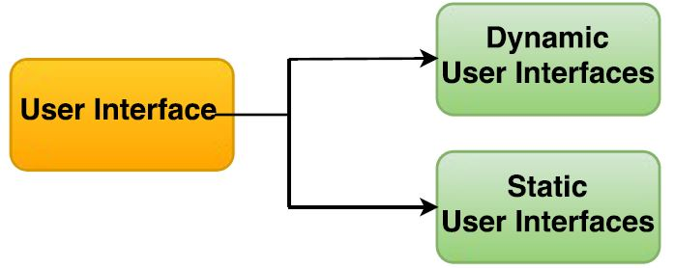
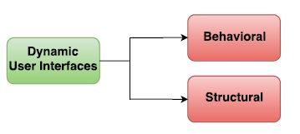
Augmented Framework Development
In the Augmented framework development process, First Step is the User Interface Development. It has the two steps as shown in the following Figure 3.
Figure 3 : User Interface Development Steps
Dynamic User Interfaces are further dependent on two factors behavioral and structural as shown in Figure 4.
Figure 4 : Dynamic User Interface Categories
10

Slide 12
Augmented Framework Development (Dynamic User Interface)
Behavioral dependency:
While developing the user-interfaces of this category. The framework-developer need to look at different kinds of scenarios associated with the chosen domain where the framework is applied.
Example:
In our case study, reservation (chosen domain) of an item is made over a period of Days or Hours. So we developed the following User-Interface1 and User-Interface2.
11

Slide 13
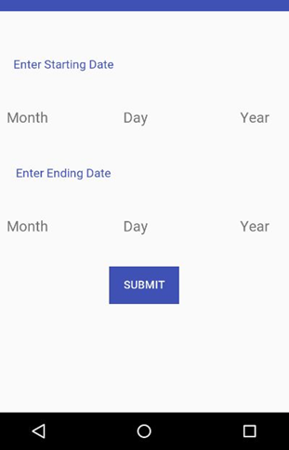
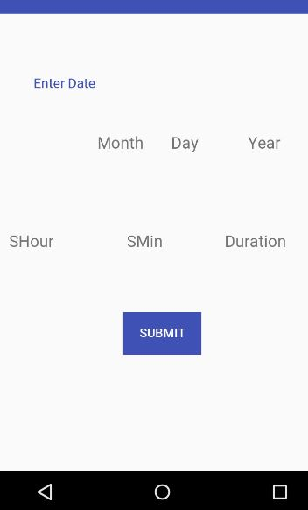
Behavioral dependency Example:
User-Interface 1, will be displayed when reservation is based on days.
User-Interface 2, will be displayed when reservation is based on hours.
User-Interface 1 User-Interface 2
* SHour → Starting Hour, SMin → Starting Minutes
12

Slide 14
Augmented Framework Development (Dynamic User Interface)
Structural Dependency:
These are the User-Interfaces which depends on the essential structures of the application.
In our case-study, the structure of the application depends on the number of Inputs. For example, we have to create a user Interface which can display buttons associated with number of inputs. So we developed the following User-Interface 3 and User-Interface 4.
13

Slide 15
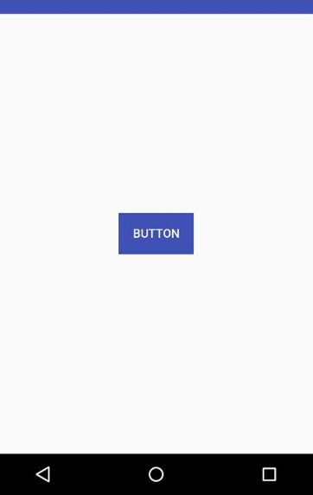
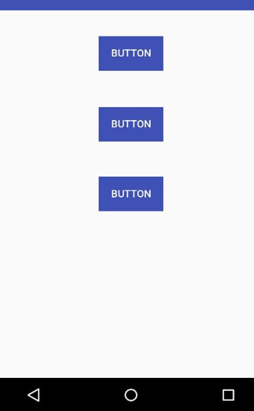
Structural Dependency Example: User-Interface 3, Will be displayed when there is only one input. User-Interface 4, Will be displayed when there is three inputs. User-Interface 3 User-Interface 4
14

Slide 16
Augmented Framework Development (Static User Interface)
The Second step in the User-Interface development process is the “Static User-Interfaces”.
These are the User-Interfaces that are associated with the user interfaces that won’t change based on the input at runtime.
In our case-study, The user-interfaces associated with Login and Admin won’t change for any inputs. For those kinds of screens, we are creating a standard User-Interface.
15

Slide 17
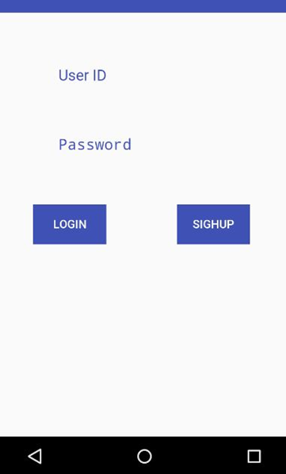
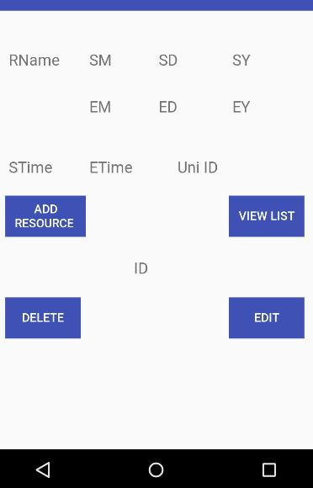
Static User Interface Example:
User-Interface 5 and 6, are the static layout associated with Login screen and Admin screen Respectively.
User-Interface 5 User-Interface 6
* Rname → Resource Name, SM → Starting Month, SD → Starting Day, SY → Starting Year, EM → Ending Month, ED → Ending Day, EY → Ending Year, STime → Stating Time, Etime → Ending Time, Uni ID → Unique Identifier
16

Slide 18
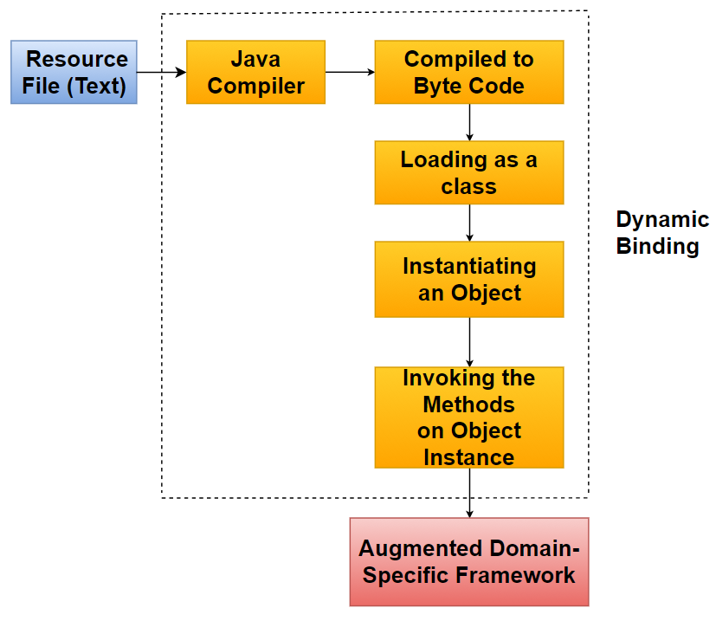
Dynamic Binding Process
17

Slide 19
Example of Dynamic Binding Technique
Text File: public class Test {
private int x = 5;
public int getX() {
System.out.println("x="+x);
return x; }
}
File sourceFile = new File("Test.java"); // Defining the resource File
System.setProperty("java.home", "C:\\Program Files\\Java\\jdk1.8.0_151");
JavaCompiler compiler = ToolProvider.getSystemJavaCompiler();
compiler.run(null, null, null, sourceFile.getPath()); // Compiling to Byte Code
Class params[] = {};
Object paramsObj[] = {};
Class thisClass = Class.forName("Test"); // Loading as a class
Object iClass = thisClass.newInstance(); // Instantiating an Object
Method thisMethod = thisClass.getDeclaredMethod("getX", params);
thisMethod.invoke(iClass, paramsObj); // Invoking the Methods on Object Instance
Java Compiler Creation
18

Slide 20
Resource Integration by using Dynamic Binding
public interface Resource{
public Static getHorD();
public Static[][] getResourceMatrix();
public Static timePeriod();
}
public class RoomReservation implements Resource {
public String getHorD(){ return "H"; }
public String[][] getResourceMatrix() {
String[][] resourceGrid = {
{"RM 101","1","0.1","0.1","0.1","0.1","0.1","0.1","0.1","0.1"},
{"RM 102","1","0.1","0.1","0.1","0.1","0.1","0.1","0.1","0.1"}, };
return resourceGrid; }
public String timePeriod(){ return "3"; }
}
Interface in the Framework
External
Classes
Containing Data
19

Slide 21
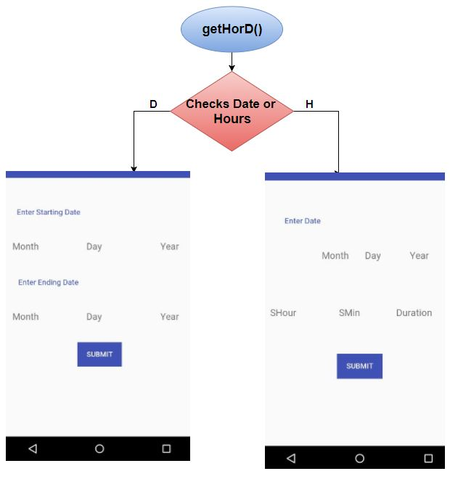
User-Interface Logic
User-Interface Logic to auto displaying appropriate screens based on Dynamic Data.
20

Slide 22
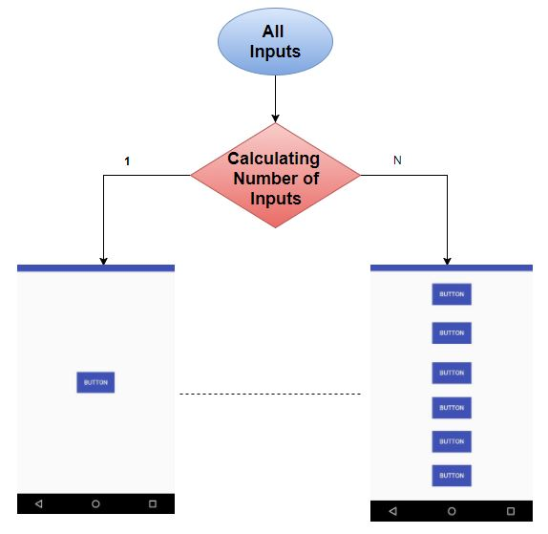
User-Interface Logic
User-Interface to Auto display appropriate screens based on number of Dynamic Inputs.
21

Slide 23
Evaluation
Developed guidelines for creating Aug Domain-specific Framework.
Framework will be able to handle user Interface with transition.
Dynamic Binding is used to integrate external information and translate into executable code.
22

Slide 24
Conclusion and Future work
Applications for Mobile phones have limited support in frameworks
Developing tools for generating mobile app with domain knowledge is not adequately implemented
Methodology provides the guidelines to create domain-specific frameworks effectively.
23

Slide 25
LIST OF REFERENCES​
[DeRemer, 1975] DeRemer, F., and H.H. Kron, “Programmingin-the-Large Versus Programming-in-the-Small,” IEEE Trans. on Sojtware Eng., June1976.
[Brooks, 1989] Brooks, F.P. No silver bullet. IEEE Comput. 20, 4 (Apr. 1987), 10-19.
[G.Rogers, 1997] G. Rogers, Framework-Based Software Development in C++, Upper Saddle River, N.J., Prentice Hall, 1997
[Glez, 2000] F. Fdez-Riverola, D. Glez-Pen˜ a, H. López-Fernández, M.Reboiro-Jato, J.R.A. Méndez, Java application framework for scientific software development, 2000
[Ponder, 2003] Ponder M, Papagiannakis G, Molet T, Magnenat-Thalmann N, Thalmann D. VHD++ development framework: towards extendible, component based VR/AR simulation engine featuring advanced virtual character technologies. In Proceedings of Computer Graphics International (CGI). IEEE Computer Society Press, 2003.
[Greenfield, 2004] J. Greenfield et al., Software Factories: Assembling Applications with Patterns, Models, Frameworks and Tools, John Wiley & Sons, 2004.
24

